Slide 1
Data Analytics
Arcot (Raja) Rajasekar
rajasekar@unc.edu
Unit #04

Slide 2
Unit #04
Unsupervised Learning
Similarity & Clustering in Data Analytics

Slide 3
Fundamental Concept in IA:#5
Similarity
Basic Idea: If two things are similar in some ways, they often share other characteristics
Remember: Decision Trees segment based on ‘similarities’ of some attribute values:
  Ex: Age > 60, Own_House, salary, …
  Ex. Weights in Regression Discriminants
Similarity is a fundamental concept in Data Mining
  Searching for similarity and patterns form the basis for Information Informatics

Slide 4
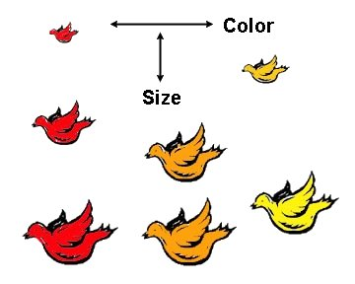
Similarity in Use Cases
Classification and Regression similarities
Clustering similarities
  IT workers, State, Millenials, …
Recommendation system - long tail retailing
  Amazon, Music, Stock recommendations, …
Similar population analysis
  Medicine & Disease classification
  Students (for Admission)
Similarity in Law
  Case Laws
Similarities in Science
  Biology Species classification www.pigeon.psy.tufts.edu
  Ecology and diversity

Slide 5
Measurement of Similarity: Distance
“Distances” between data objects are used
for the determination of similarity
  A measure of similarity or dissimilarity
  A numeric value of similarity – on some scale
  Less similar more distance
  Ex: Age, Weight, Salary
Non-numeric to Numeric similarity scale:
  Attributes to numeric
  Comparable in numeric scale
  Can be multi-dimensional number
  Can be viewed as a signature

Slide 6

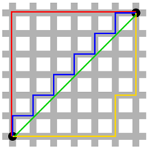
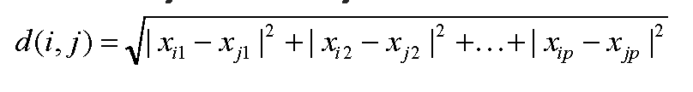

Some Distance Measure
Manhattan distance: step distance
  more robust, and more realistic
Euclidean distance: direct line
  Shortest distance, as the crow flies
Minkowski distance:
  Generalization of Manhattan
  Hyper plane distnaces
Manhattan
B
A
Euclid

Slide 7
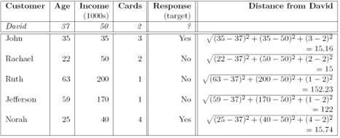
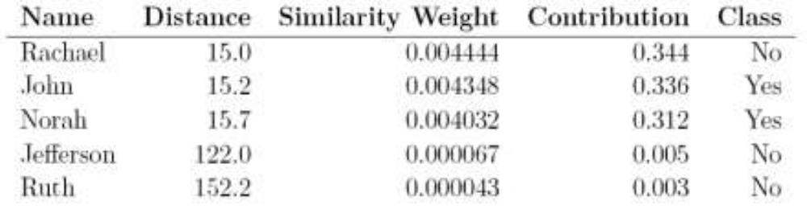
NN - Example

Slide 8
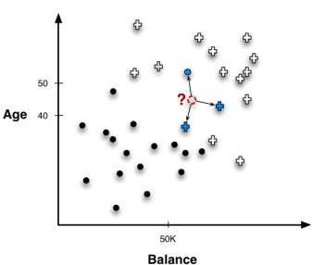
Nearest Neighbor (NN)
One method of similarity – a very powerful method
Majority Vote of N
Influence of Neighbors
  How many neighbors
  are similar?
Influence of Distance
  Shortest or Average?

Slide 9
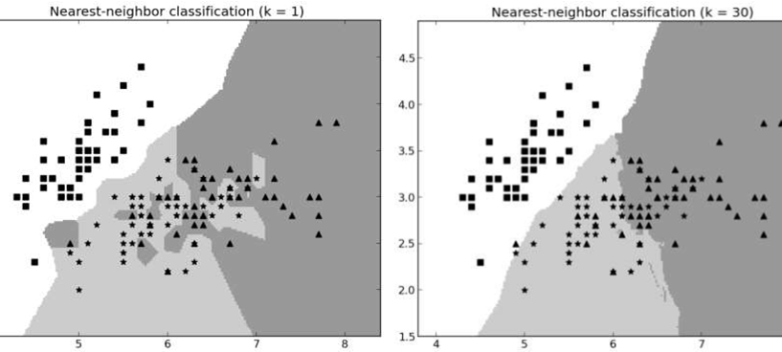
Nearest Neighbor –Influence
Trying to classify squares, triangles and stars
Nearest neighbor classifiers follow very specific boundaries
k-NN strongly tends to overfit when k is low
k is a complexity parameter – how many neighbors influence
Use cross-validation or nested holdout testing for multiple k’s

Slide 10
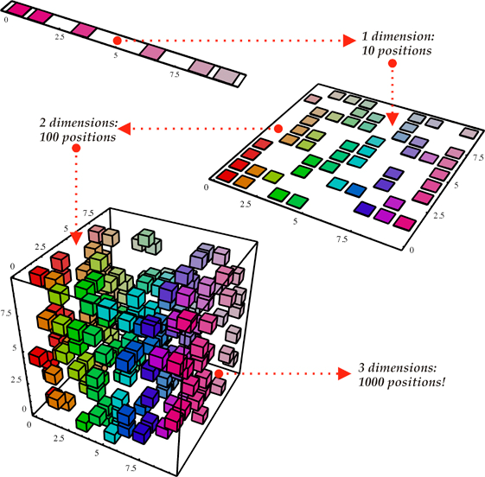
Problems with Computing NN
Curse of Dimensionality
  Having too many/irrelevant attributes
  may confuse distance calculations
    Solution 1: Feature selection
    Solution 2: Inject domain knowledge
    in distance calculation
Computational Efficiency
  Querying the database for prediction
  can be very expensive
  NN methods lack of specific decision
  models
Intelligibility
  Decisions can be explained along the contributions of the neighbors:
    The movie Billy Elliot was recommended based on your interest in Amadeus, The Constant Gardener and Little Miss Sunshine”
Yosuha Benjio
www.iro.umontreal.ca

Slide 11
Cluster Analysis

Slide 12
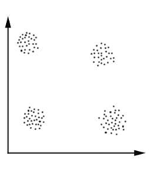
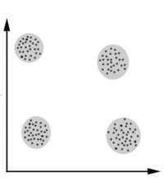
Definition
Clustering is the process of grouping data into classes or cluster so that objects within a cluster have high similarity in comparison to one another, but are very dissimilar to objects in other clusters
Clustering captures concepts of similarity and dissimilarity

Slide 13
Cluster Analysis
Derive Clusters from Training set
Clustering is an example of
unsupervised learning
We don’t have a target variable!!!!
Two main purposes:
  Discovery of overall distribution patterns and interesting correlations among data attributes
  Data reduction: a cluster can be treated collectively as one group in many applications
  Ex. Computing Mean

Slide 14
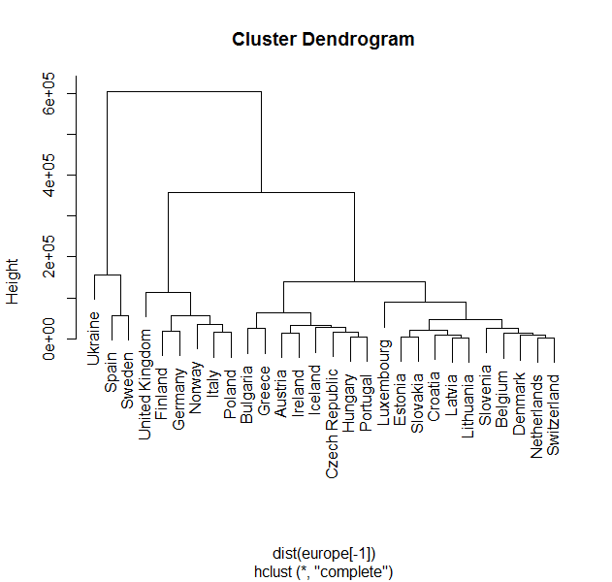
Applications of CA
Help marketers discover distinct groups
in their customer databases and
characterize customer groups
based on purchasing patterns
Derive plant and animal taxonomies
in biology, categorize genes based on
similar functionality
Identification of groups of automobile
insurance policy holders with a high average claim cost
Classify documents on the web for information discovery
„Gain insight into the distribution of data
Preprocessing step for other tasks such as classification
  Ex. Reduce numeric Salary attribute to a few ranges.
www.instantr.com

Slide 15
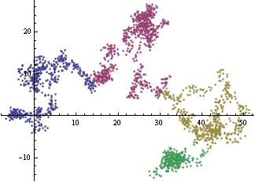
Some Aspects of CA
Cluster algorithms work well on small low dimensional data sets and numerical attributes
  Scalability
    Parallel Algorithms
  Different types of attributes
    Binary, categorical, ordinal,
    time series
    May be less informative
Clusters can be of arbitrary shape
  Not all clusters are shaped like a circle!!
www.wolfram.com

Slide 16
Some Problems with CA
Domain knowledge required to determine input parameters and evaluate results
  Informative Attributes
Deal with noisy data
  Outliers can massively influence the clustering
  Insensitivity to the order of input records
„ High dimensionality
  Non-linear Computational Complexity
„ Interpretability and usability
  Hard to explain in multiple dimensions

Slide 17
What Is Good Clustering?
A good clustering method will produce high quality clusters with
  high intra-class similarity
  low inter-class similarity
The quality of a clustering result depends on both the similarity measure used by the method and its implementation.
The quality of a clustering method is also measured by its ability to discover some or all of the hidden patterns.

Slide 18
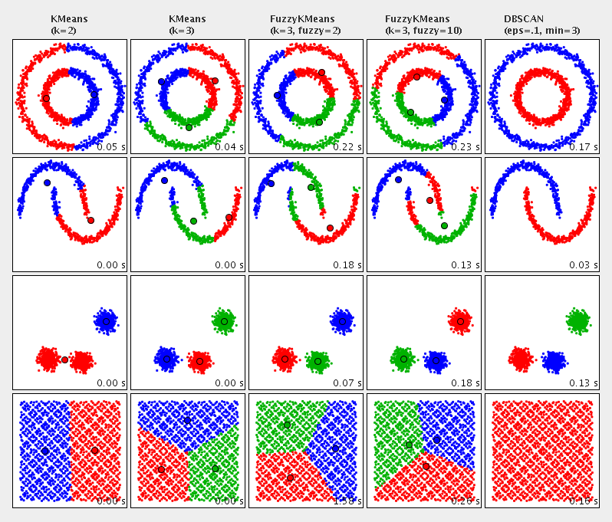
Clustering Algorithms
Partitioning based clustering
  K-means, Fuzzy K-means
  K-medoid
Hierarchical clustering
  K Nearest Neighbor
    Chameleon
  Density-based clustering
    DBSCAN
  Grid-based clustering
    STING
Model-based Methods
    Neural Networks
    Genetic Algorithms
    Basket Analysis
https://commons.apache.org/

Slide 19
Clustering Algorithm Selection
A large number of clustering algorithm exist
The choice of cluster algorithm depends on
  the type of data available
  number of data objects and variables
    features of the data set
  representation of results
    the particular purpose and application
  domain knowledge required
  type and structure of clustering needed
  type and definition of clusters

Slide 20
Goodness of a Clustering
Inter-cluster Goodness:
R_{ij} = ( S_{i} + S_{j} ) / d_{i j}
R_{ij} is small when distances between clusters are large and variations inside the clusters are small
  A measure of “good clustering”
Goodness of Individual Cluster C_{i}
R_{i} = Max _{j= 1…k} (R_{ij} )
R_{i} is the worst inter-cluster goodness between cluster C_{i} and any other cluster.
R_{ij} and R_{i} are numeric values. No units
Smaller values for R_{ij} and R_{i} are better.

Slide 21
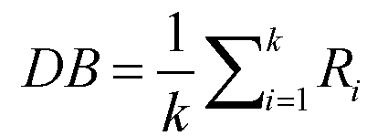
Davies-Bouldin Index
DB Index - Average of all individual cluster goodness
DBI is independent of clustering algorithm
Comparison between two clusters
  Two Clustering done by two algorithms, or
  Two Clustering done by tweaking parameters of same algorithm
  Manual generated cluster against a machine-generated cluster
  Important use same distance measure for both DBI computation
Compute DBI for the clusters
  Smaller the DBI better the cluster compared to another cluster
Iterate (parameter sweep) to find the best clustering

Slide 22
Clustering Tendency
A measure of goodness of dataset
Is the set of instances a “good” dataset for clustering
Does the given data set tend to natural clusters?
  That is, how close to “reality” is the clustering of the instances
Spatial Randomness of the dataset
  Measure of clustering tendency of dataset
  Is the dataset truly random – covering the problem space?
  Is it bunched together missing important regions?
How can we test for spatial randomness?
  Hopkins Test or Hopkins Statistics

Slide 23
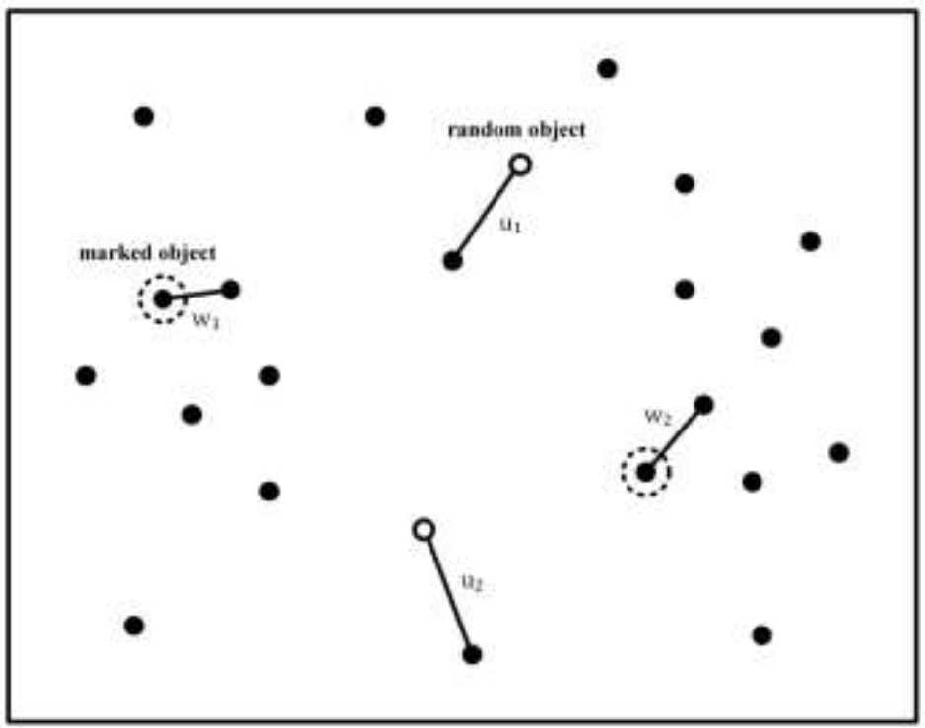
Concept of Hopkins Statistics
Compare input instances to randomly generated data
How close is the random dataset to the original dataset
If it is close, we have a good input dataset
In the diagram:
Black objects are points in input dataset
Red objects are randomly generated objects
Dotted circle objects are randomly chosen marked input objects
We have 2 randomly marked input objects and
2 randomly generated objects in the space
w₁ , w₂ are nearest neighbor distances to marked objects
u₁ , u₂ are nearest neighbor distances to generated objects
Compare sum of w₁ , w₂ to sum of u₁ , u₂
If random objects’ sum are smaller
then you have a problem

Slide 24
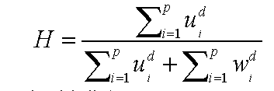
Hopkins Statistics
Assume your dataset has d dimensions and n input instances
Generate 𝑝 objects in 𝑑-dimensional data space randomly
Choose randomly 𝑝 objects in the original data set and mark them
Find nearest neighbors for both sets and add their distances
If H ≤ 0.5 then input data is randomly distributed
If H > 0.5 then data set will cluster well
Larger the H better the input data
  Sum of w’s (neighbors of input objects) are smaller than sum of u’s (neighbors of generated objects)
  That is, input objects are clustered more than random objects

